Slide 1
Java JDBC
Mr Giridharan M.E.,M.B.A.,
Assistant Professor, Dept of CSE,
Sri Eshwar College of Engineering.
Coimbatore – 641202.

Slide 2
Java JDBC
JDBC Driver
Java Database Connectivity with 5 Steps
DriverManager class
Connection interface
Statement interface
ResultSet interface
Batch Processing in JDBC

Slide 3
JDBC Driver
There are 4 types of JDBC drivers:
JDBC-ODBC bridge driver
Native-API driver (partially java driver)
Network Protocol driver (fully java driver)
Thin driver (fully java driver)

Slide 4
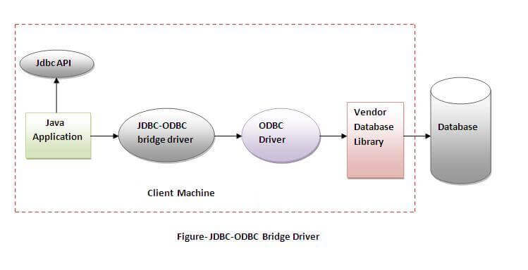
JDBC-ODBC bridge driver

Slide 5
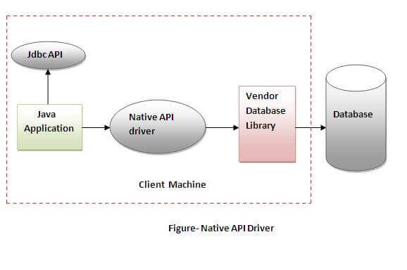
Native-API driver

Slide 6
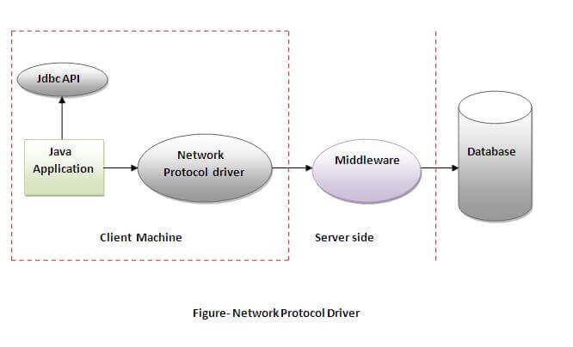
Network Protocol driver

Slide 7
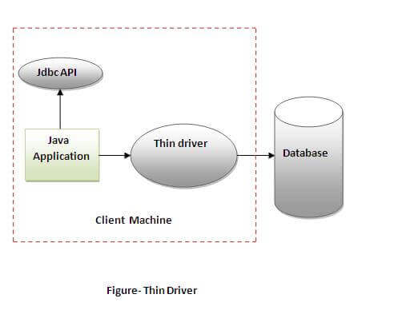
Thin driver

Slide 8
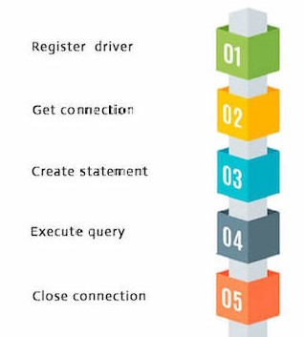
Java Database Connectivity Steps
There are 5 steps to connect any java application with the database using JDBC.
Register the Driver class
Create connection
Create statement
Execute queries
Close connection

Slide 9
Register the driver class
The forName() method of Class class is used to register the driver class.
Class.forName("oracle.jdbc.driver.OracleDriver");
Class.forName(“mysql.jdbc.driver.MySqlDriver");
Create the connection object
Connection con=DriverManager.getConnection(
“jdbc:mysql://localhost:3306/student",“root",”root");

Slide 10
Java Database Connectivity steps
Create the Statement object
Statement stmt=con.createStatement();
Execute the query
ResultSet rs=stmt.executeQuery("select * from emp");
Close the connection object
con.close();

Slide 11


